Slide 1
Data Structures
Lecture-14
Stacks
Queues
Prateek Narang

Slide 2
Header Files
Notes:
Make them create one file from next time

Slide 3

Recursion and Pile of Books
Notes:
Input S = "1123"
Output –
aabc // a = 1, a = 1, b = 2, c = 3
kbc // k = 11, b = 2, c = 3
alc // a = 1, l = 12, c = 3
aaw // a = 1, a = 1, w = 23
kw // k = 11, w = 23

Slide 4
Stacks
Notes:
Make them create one file from next time

Slide 5
Templates
Notes:
Make them create one file from next time

Slide 6
Stacks
class Stack{
// accessor methods
int size();
bool isEmpty(); int top();
// update methods void push (int element); void pop();
}
Notes:
Talk about circular linked list

Slide 7
How to implement Stack Class?
Arrays
Linked List
Notes:
http://www.vogella.com/tutorials/JavaDatastructureList/article.html

Slide 8
Dynamic Arrays
Notes:
Make them create one file from next time

Slide 9
Lets Implement Our Own Stack Class Using a Dynamic Array
Notes:
Make them create one file from next time

Slide 10
Your Turn: Implement Stack Class Using Linked List
Notes:
Make them create one file from next time

Slide 11
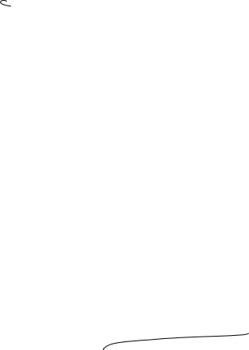

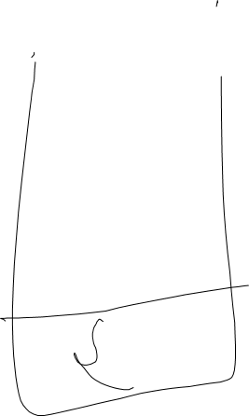
Lets solve few problems
Given an expression check if brackets are balanced e.g. { a + [ b+ (c + d)] + (e + f) }
Reverse a Stack with the help of recursion(stack)
Notes:
Talk about head of linkedlist

Slide 12
Queues
Notes:
First in first out

Slide 13
Queue
class Queue{
// accessor methods
int size();
bool isEmpty(); int front();
// update methods void enqueue(int element); int dequeue();
}
Notes:
Talk about circular linked list

Slide 14
How to implement Queue Class?
Linked List
Arrays
Notes:
Talk about circular linked list

Slide 15
Lets Implement Our Own Queue Class Using Arrays
Notes:
Make them create one file from next time

Slide 16
Your Turn: Implement Queue Class Using Linked List
Notes:
Make them create one file from next time

Slide 17
Lets solve few problems
Reverse a Queue
Implement a Stack using Two Queues
Notes:
Talk about head of linkedlist

Slide 18
Thank You!
Prateek Narang

